Slide 2
Implementation of a Sub-Samlping PLL targeting SerDes Applications
Christof Gindu

Slide 3
Motivation
Master‘s thesis
Implementation of the PLL using only open-source tools
Accumulating knowledge about the complete chip design process
Share knowledge with other students, provide introduction to open-source chip design

Slide 4
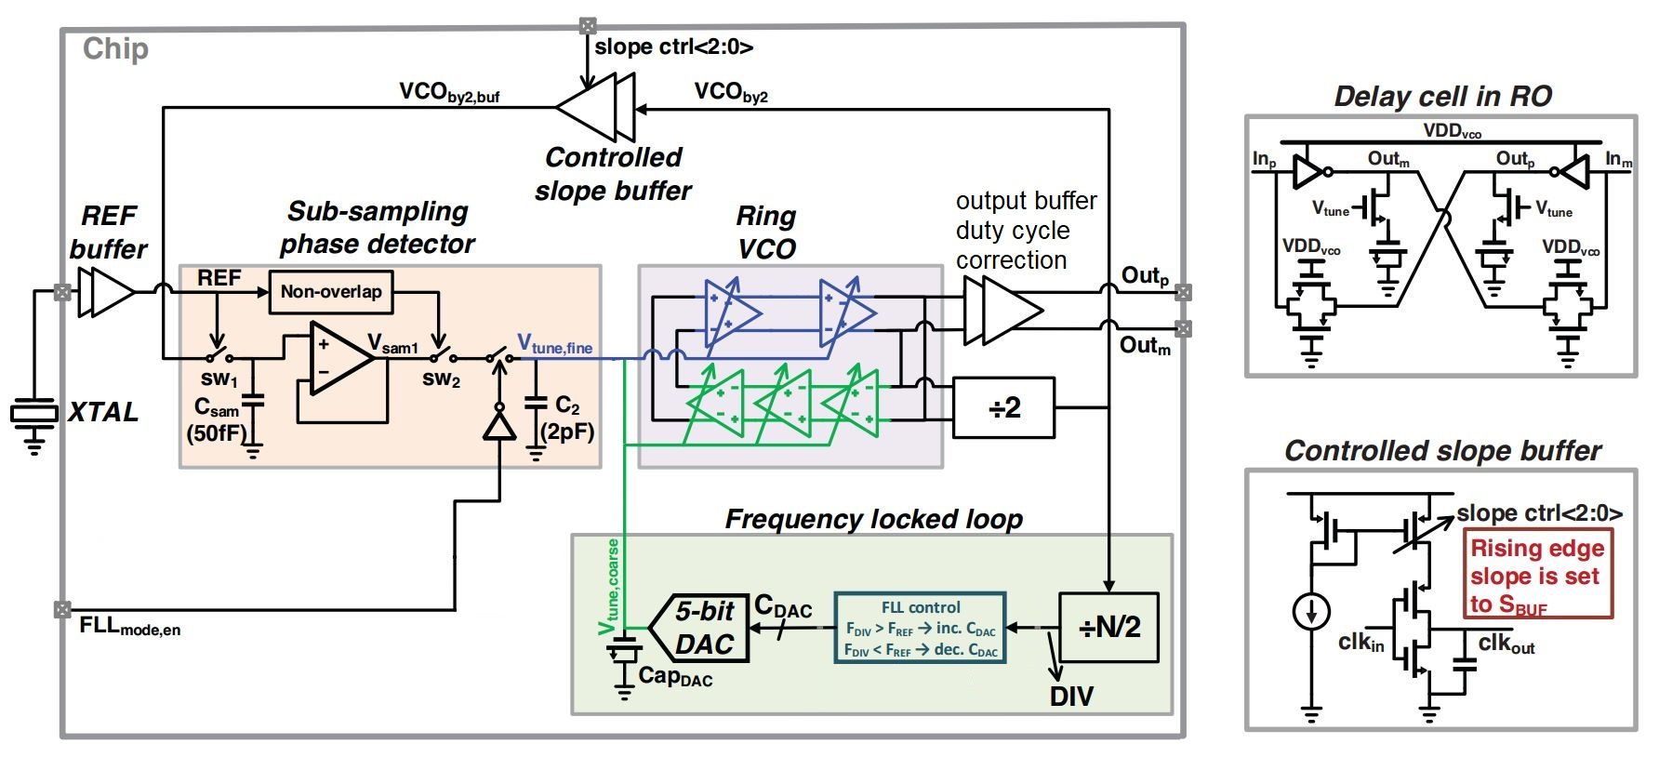
Block diagram – overview

Slide 5
Block diagram – inputs/outputs
Reference frequency supplied by a quartz crystal
Serial input for controlling the individual components
Read input for viewing current system configuration
Load input for setting new system configuration
Clock input for synchronouse serial data transmission
Reset input for resetting the complete chip
Serial output for reading current system configuration
Frequency output which features divided VCO frequency

Slide 6
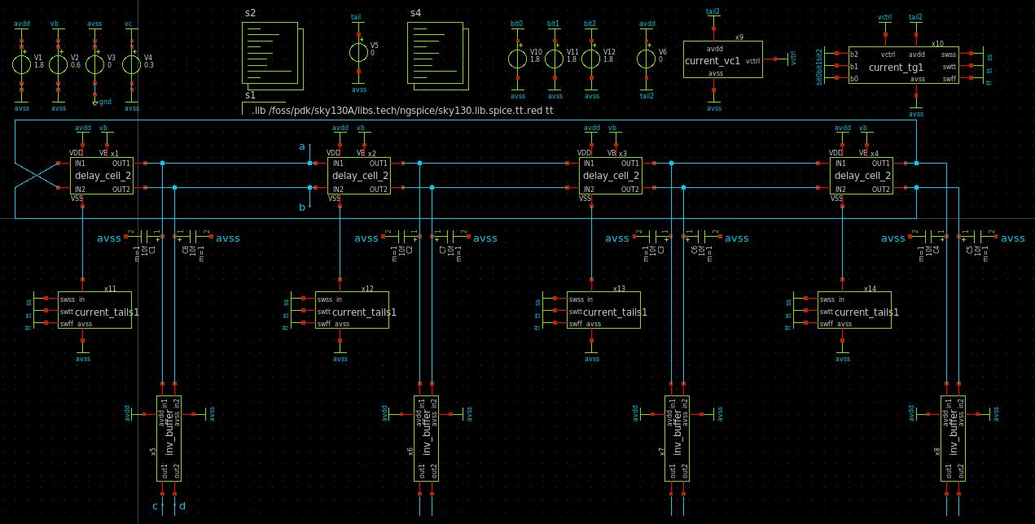
Block diagram – VCO

Slide 7
Block diagram – FLL control
Divided output frequency captured by counter
Counter value is compared to defined value
DAC provides control voltage to VCO
Switching between process corners ss/tt/ff

Slide 8
Block diagram – Sub-Sampling Circuit
Symmetrical OTA for charging/discharging Capacitance
Switches realized as T-gates

Slide 9
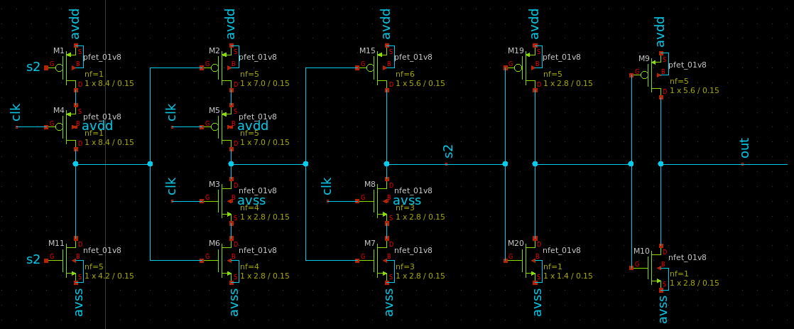
Block diagram – dividers and buffers
Custom div2 frequency divider for VCO output
Programmable frequency divider for reference input
Buffers layouted in standard sizes

Slide 10
Verification – SPICE simulation
Simulation of designed schematic
Simulation of extracted layout
Stimuli generated according to desired functionality, tested at corners
Circuits tested in ss/tt/ff corners where necessary + at temperatures -40/+125 °C

Slide 11
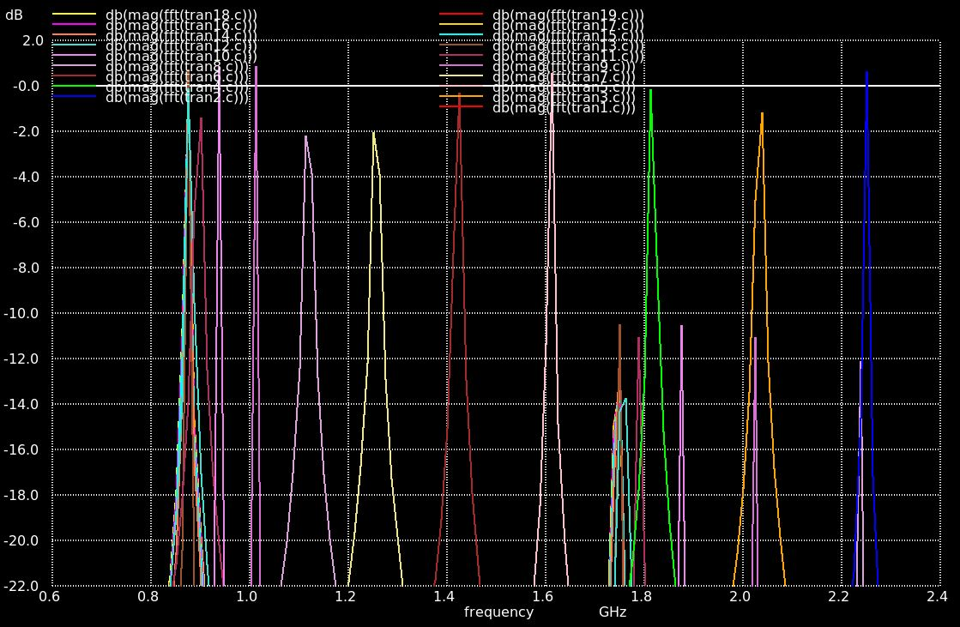
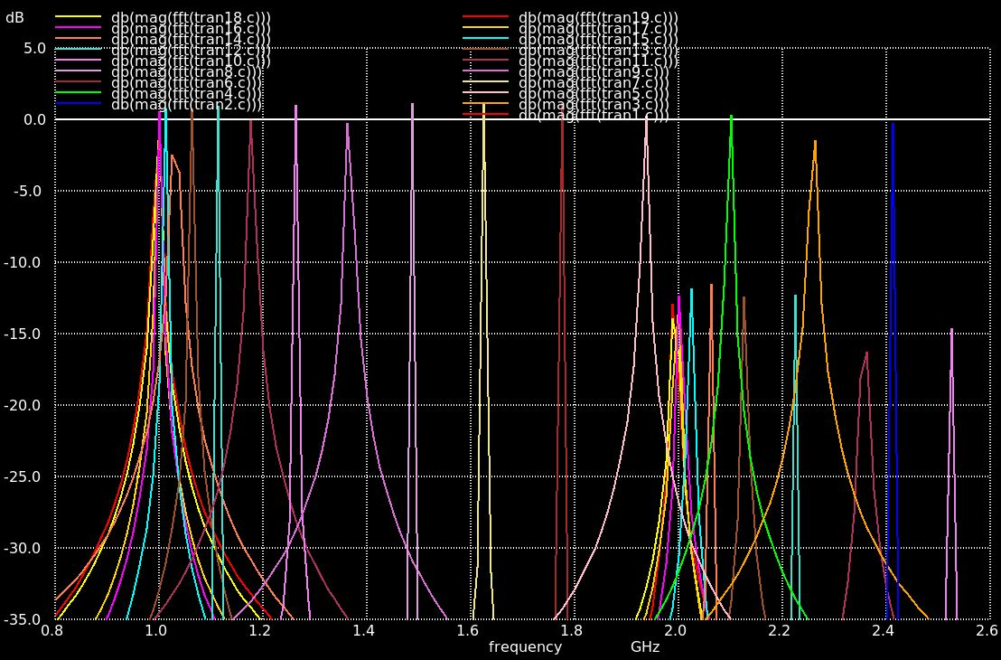
Simulation results – VCO
tt corner at -40/+125 °C

Slide 12
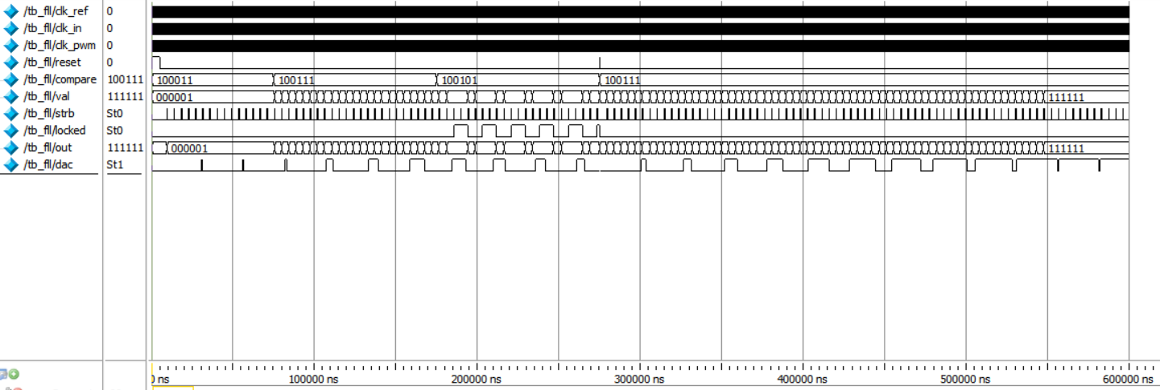
Simulation results – FLL control
Increase – decrease – locked – increase until overflow (next corner case)

Slide 13
Simulation results – Sub-Sampling Circuit
[work in progress]

Slide 14
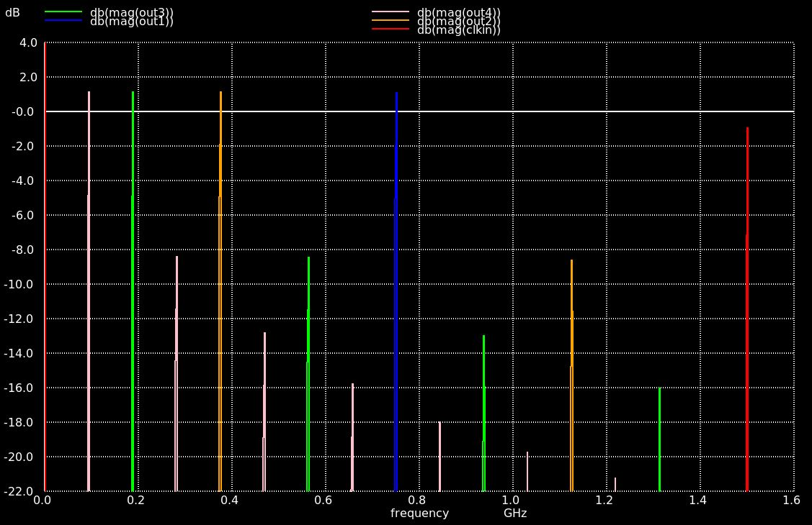
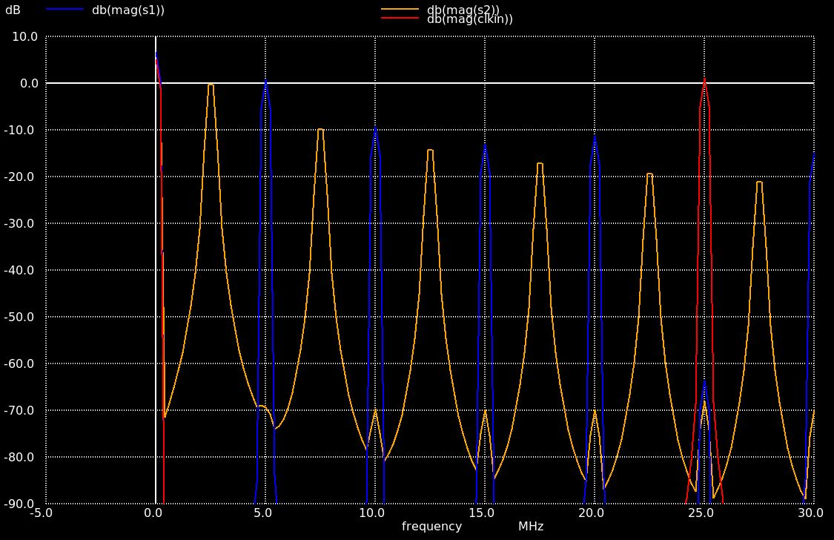
Simulation results – dividers and buffers
4 times custom div2 divider reference divider div5/div10

Slide 15
Verification – Summary
Component | Test done? | Test passed?
VCO | Yes | Yes
FLL control | Work in progess | Yes
Sub-Sampling Circuit | No | -
Dividers and buffers | Yes | Yes

Slide 16
Initial Results – overview
Layout will probably be digital-on-top
Not all components layouted yet
„dummy implementation“ – just placing all components in a new magic file

Slide 17
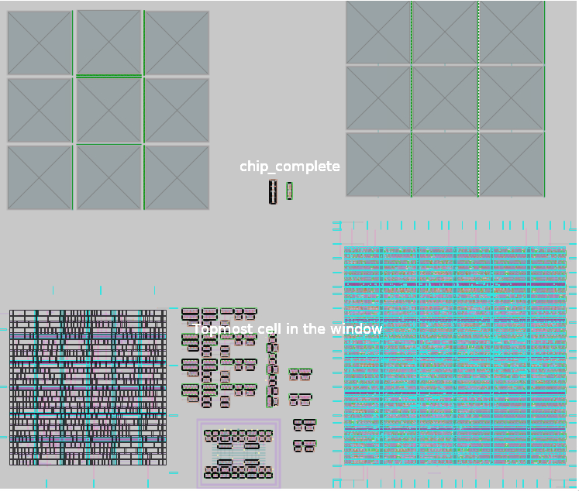
Initial results – figures
Digital components:
FLL control – 85x95µm
Dividers/shift register – 120x130µm
Very rough total estimate – 250x300µm
Analog components:
VCO core – 70x90µm

Slide 18
Caravel integration – overview
Teams: Austria, USA1, Brazil
Shared pin list: https://docs.google.com/spreadsheets/d/1W1POMTv0muYGoTeH6-UFIFluaF-aqXRq3irdcskvrYA/edit#gid=1686940366
Shared GitHub repository for design merge: https://github.com/UAH-IC-Design-Team/sscs-22-project-wrapper
Had a meeting for discussing area, pin sharing, integrity issues, …
No interaction with the SoC

Slide 19
Caravel integration – merging plan
Designs will be uploaded to the shared GitHub repository
Merging will be done by hand using the GDS files of the individual designs

Slide 20
Caravel integration – pins and power
No overlap between I/O pins
Some remaining Caravan Analog pins used for power supply
Power | Voltage | Team
VCCD1/VSSD1 | 1.8V | USA1
VCCD2/VSSD2 | 1.8V | Austria Digital
VDDA1/VSSA1 | 3.3V/1.8V | Austria Analog
VDDA2/VSSA2 | 3.3V/1.8V | Austria VCO
Caravan 1 |  | Brazil
Caravan 2 |  | Brazil
Caravan 3 |  | Brazil
Caravan 4 |  | Brazil
Caravan 5 |  | Brazil
User area supply | GPIO used as analog | GPIO used as digtal | Caravan analog | Caravan clamp
17 | 4 | 19 | 6 | 0

Slide 21
Caravel integration – more teams?
Already 3 teams on one chip
Maybe Egypt2 with 12pins + 2mm^2

Slide 22
Schedule – strategies
finish all components (simulations, layouting, extraction+verification)
Layout strategy: finish analog layout as soon as possible, digital layout by OpenLane
Create wrapper for submission to design merge, probably done digital-on-top by OpenLane
Upload final results to shared GitHub for merging

Slide 23
Schedule – milestones
Finish all simulations
Finish all analog layouts
Finish all extractions+verifications of the analog blocks
Finish all digital layouts
Finish all extractions+verifications of the digital blocks
Finish creating project wrapper
Finish upload final results

Slide 24
Useful links
GitHub page of project: https://github.com/ChrisG1997/pll2022
Efabless page of project: https://platform.efabless.com/projects/923
GitHub page of shared Caravel: https://github.com/UAH-IC-Design-Team/sscs-22-project-wrapper
Pin list of shared Caravel: https://docs.google.com/spreadsheets/d/1W1POMTv0muYGoTeH6-UFIFluaF-aqXRq3irdcskvrYA/edit#gid=1686940366

